Slide 1
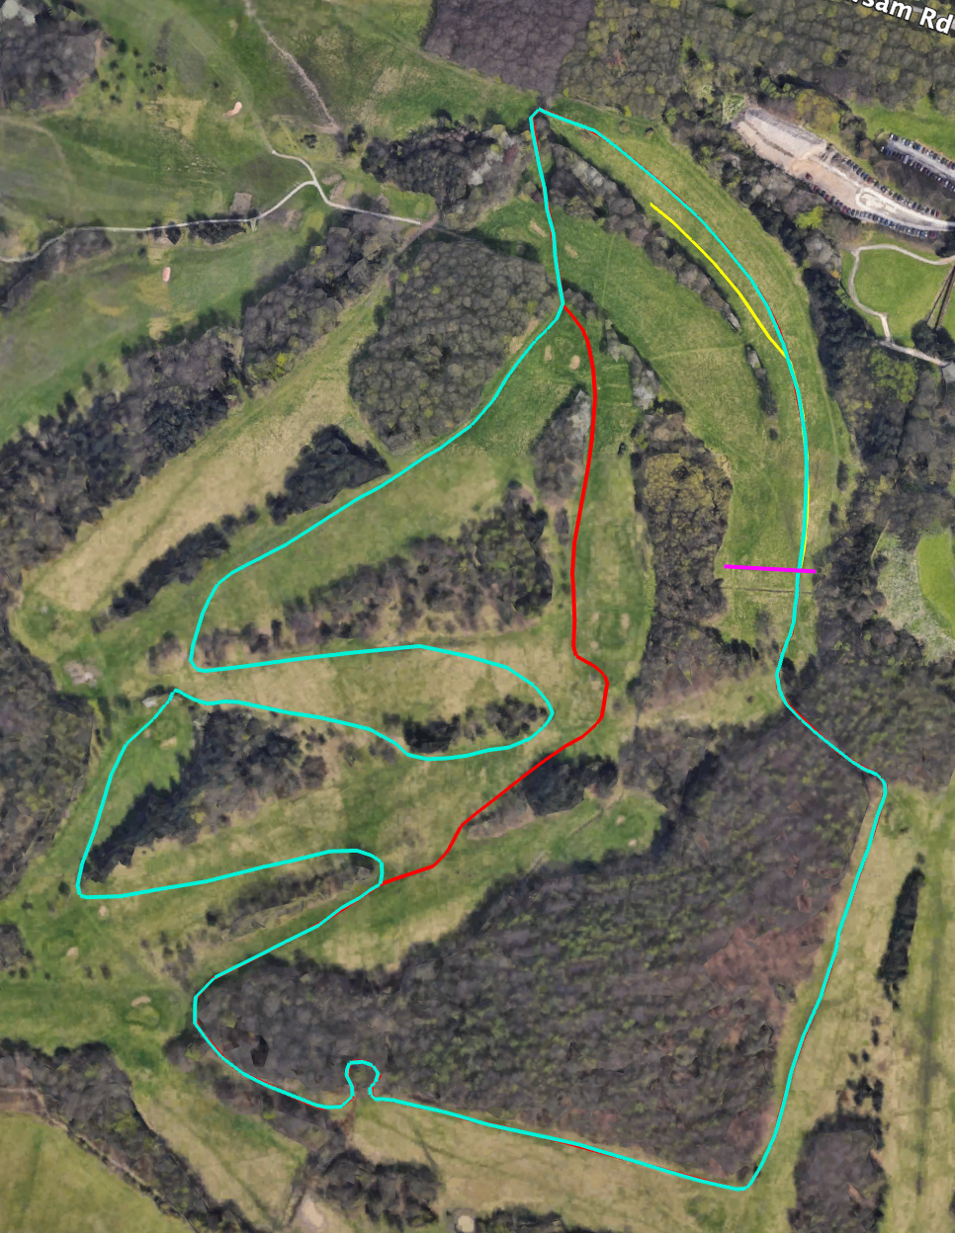
A
Finish
B
Start
C
G
H
F
D
E

Slide 2
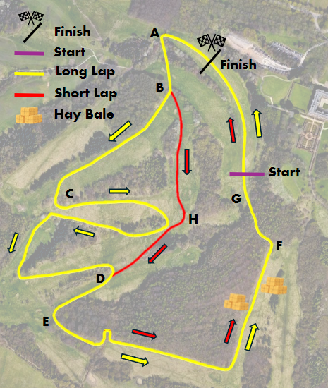

Slide 3
Women’s Short Course: 2 x Long Lap
Start, A, B, C, D, E, F, G, A, B, C, D, E, F, G, Finish
Men’s Short Course: 2 x Short Lap, 1 x Long Lap
Start, A, B, H, D, E, F, G, A, B, H, D, E, F, G, A, B, C, D, E, F, G, Finish
Women’s Long Course: 2 x Short Lap, 1 x Long Lap
Start, A, B, H, D, E, F, G, A, B, H, D, E, F, G, A, B, C, D, E, F, G, Finish
Men’s Long Course: 3 x Long Lap
Start, A, B, C, D, E, F, G, A, B, C, D, E, F, G, A, B, C, D, E, F, G, Finish

